Slide 1

PET TRACKER
Aleksandra Borzecka – No. 1121546
Artur Costa – No. 1090365
Anton Fagerström – No. 1121548
Martí Domenech Gasull – No. 1121555

Slide 2
Summary of presentation
Team 2
Introduction
  Problem
  Objective
  Motivation
Proposed solution
  System
  Device
  Process
  Web Interface
  Services
Marketing
Eco-efficiency Measures for Sustainability
Ethical and Deontological Concerns

Slide 3
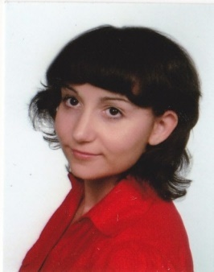
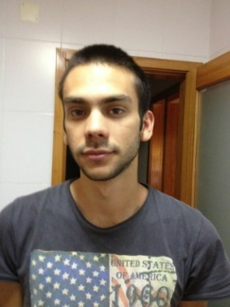
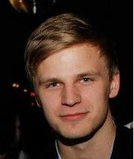

Team 2
Aleksandra Borzecka Poland Lodz University of Technology Biotechnology | Artur Costa Portugal ISEP Electrical and Computers Engineering
Anton Fagerström Finland Novia University of Applied Sciences Industrial Engineering and Management | Marti Domenech Gasull Spain (Catalonia) Escola Politècnica Superior d'Enginyeria de Vilanova i la Geltrú Computer Engineering

Slide 4
Introduction
Problem
There are no devices on the European market that offer both tracking and activity
monitoring systems for animals
Objective
To design and develop a pet tracking
and activity monitoring system
Motivation
We are pet owners
We want to use our engineering skills to create something useful

Slide 5
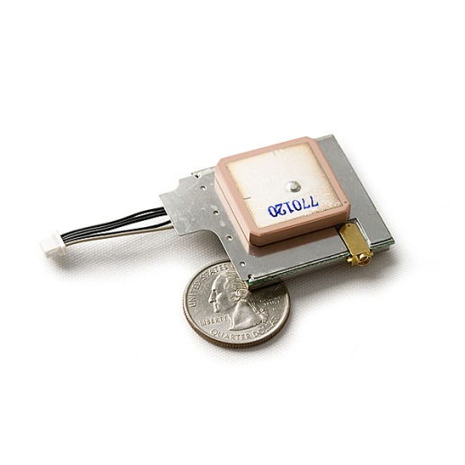
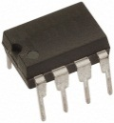
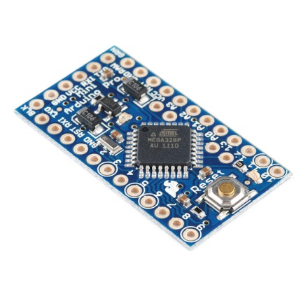
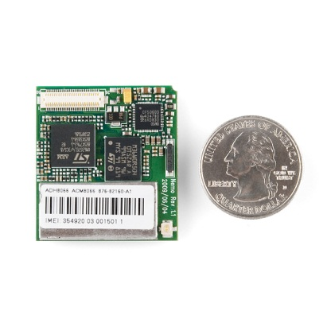
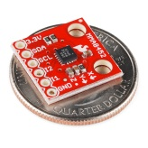
System
GPS
On board data storage
GSM/GPRS
Accelerometer

Slide 6
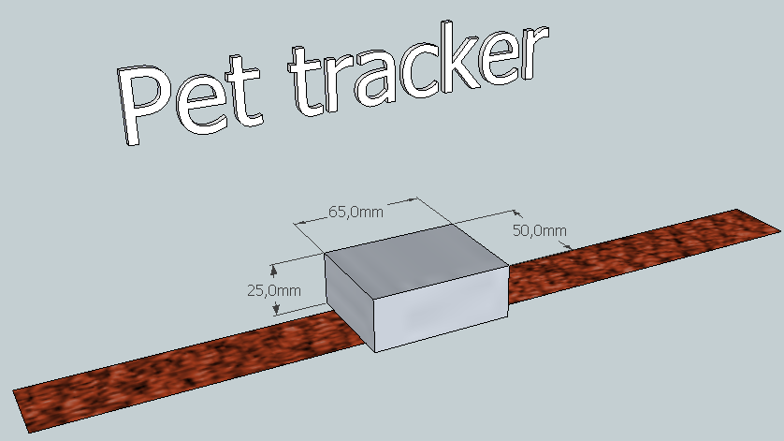
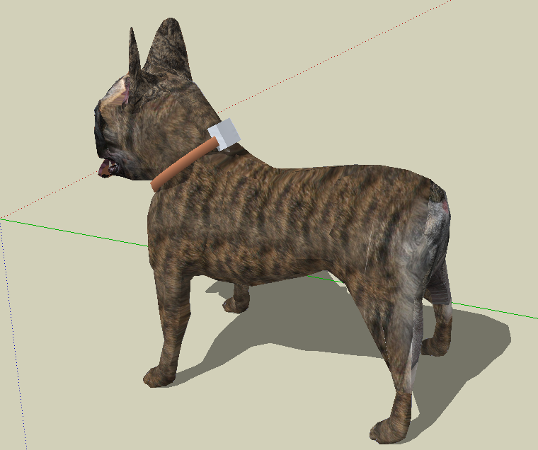
Device

Slide 7
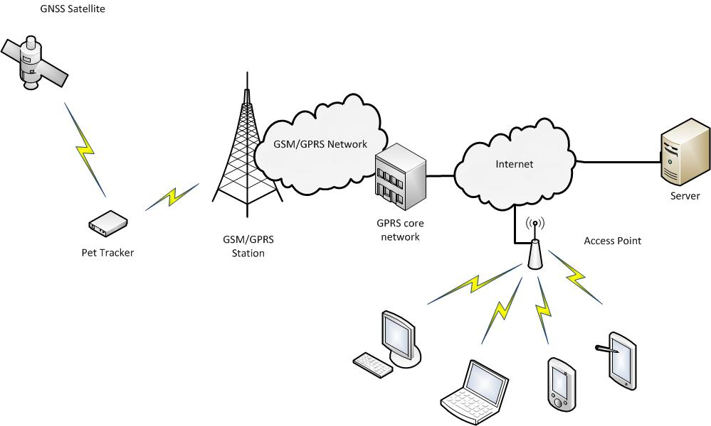
Process

Slide 8
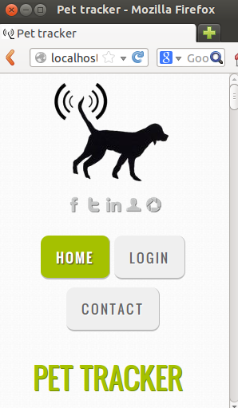
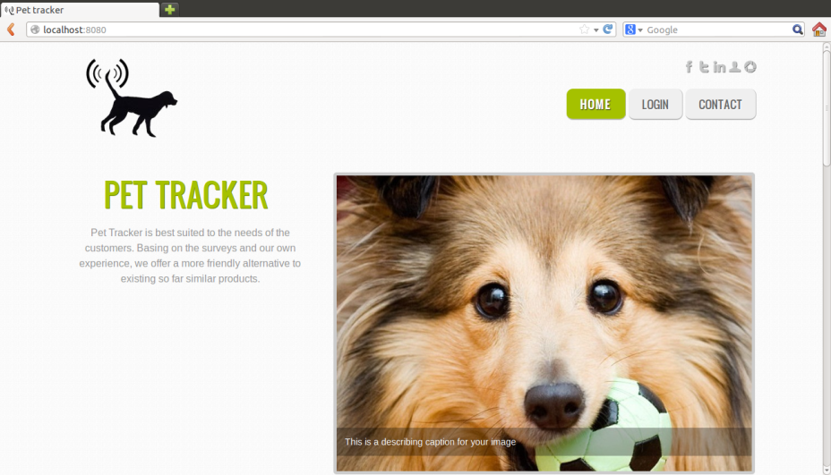
Web Interface
Open source technology
Show location of pet using Google Maps/Google Earth
Monitor pets activity using the accelerometer
RWD

Slide 9
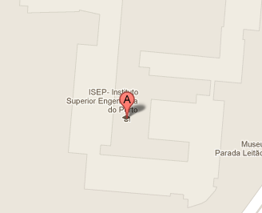
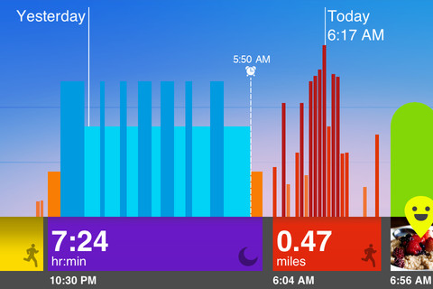
Services
Show the pet’s location with Google maps
Monitor the pet’s activity

Slide 10
Marketing
Current market situation
Unique product on the European market
People who work with animals and regular pet owners are the targeted end customers
Product to be launched in Finland
Market targeting
Market segmentation
Main competitors: Garmin and Snaptracs
Will be sold online and at dog shows at first. Retailers and veterinarian offices later.
Notes:
Berätt vaför vi vald finland

Slide 11
Marketing
SWOT analysis
Strengths
Weaknesses
Opportunities
Threaths
New product on a untouched market
Lack of experience in product development
Uses new technology
Open source technologies
Easy to use
Young adaptive development team
Main competitor does not have a strong position in the European market
Patronage of ISEP
Lack of position on the market
Limited financial resources
Limited amount of time to develop product
Create demand for such products
600 000 registered dogs in Finland
EU market untouched
Median monthly gross income in Finland is 2776€
Product acceptance
Easy for big companies to copy/improve
Main competitor drop their prices

Slide 12
Marketing MIX
Product / Consumer
Price / Cost
Place / Convenience
Promotion / Communication
Notes:
Berätt vaför vi vald finland

Slide 13
Eco-efficiency Measures for Sustainability
Usage of materials and costs
Small, light and portable product
Power consumption
and durability
Lithium-ion battery of high energy density
and low self-discharge rate
Plastic and water resistant container made to withstand all possible weather conditions
Environmentally safe components (battery does not contain toxic metals)
Safety and ecology
User-friendly web interface available for all internet compatible devices
Smart Clip-on which fits a wide range
of collar sizes
Possibility of recycling

Slide 14
Ethical and Deontological Concerns
Appropriate promotion and marketing strategy
Manufacturing process
Intellectual property issue
Recycling issue

Slide 15

Thank you for your attention!
… any questions?

